Slide 1
Council of Buyers
Year to Date Purchase and Spend Report by Organization
Steps:
Reporting->Purchasing and Spending Reports->Spend Summary Reports->Spend by Organization->Document Type is PO->Date Range->Apply->Export->Submit Request->Close->Reports->Report Exports and Extracts->Download Report Export & Extract Files->Click to Download->OK->Click to Open
Note, the steps for the Purchase and Spend Report by Organization are the same as the steps for the Purchase and Spend Report by Supplier, with the exception of slide #5.

Slide 2
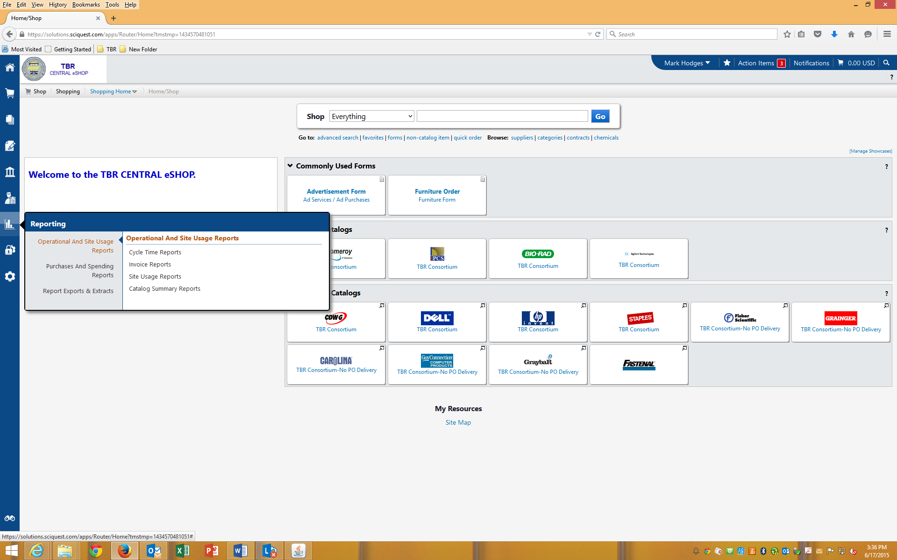
Click on Reporting

Slide 3
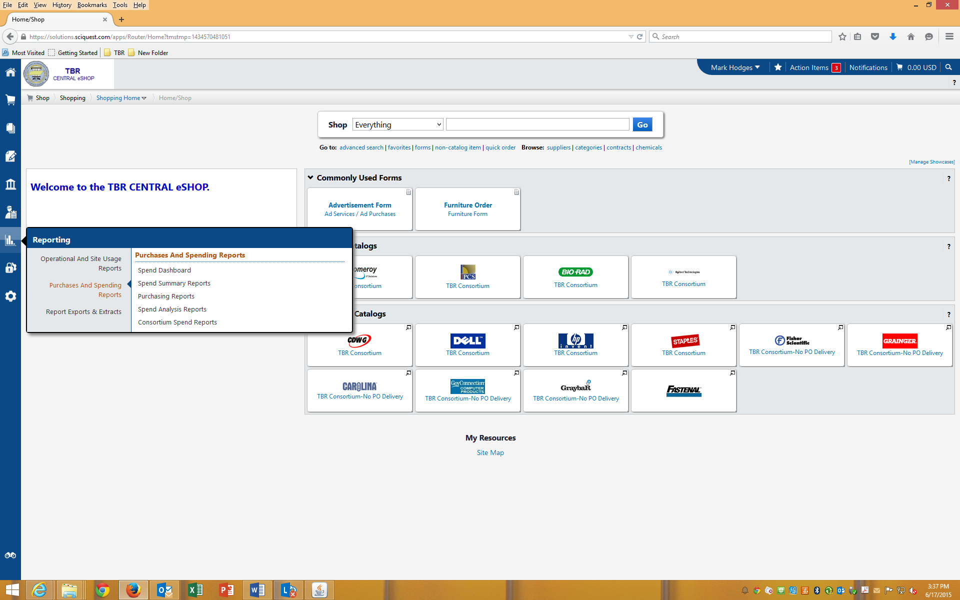
Click on Purchasing and Spending Reports

Slide 4
Click on Spend Summary Reports

Slide 5
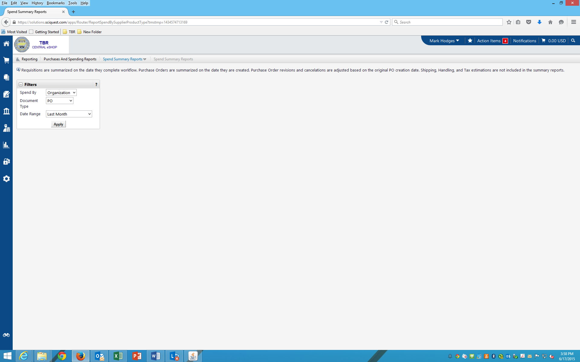
“Spend By” select “Organization”.

Slide 6
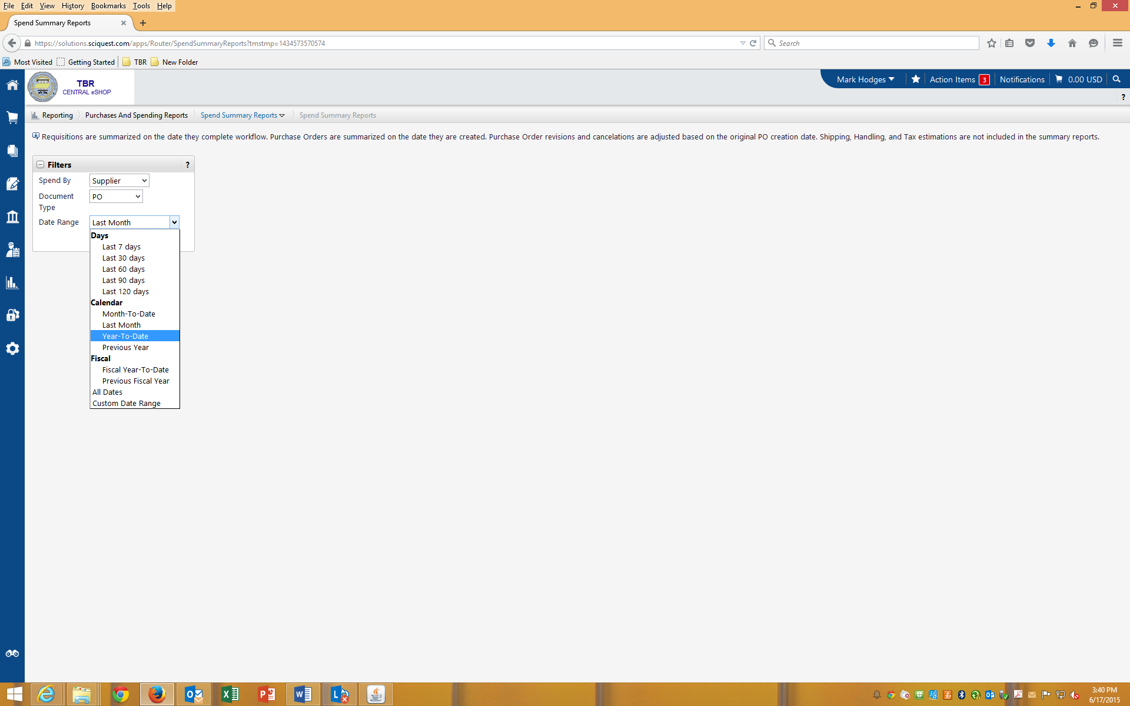
If you are able to run this report on 06/30/2015, select “Year to Date”. If you are unable to run this report on 06/30/2015, use the custom date range.

Slide 7
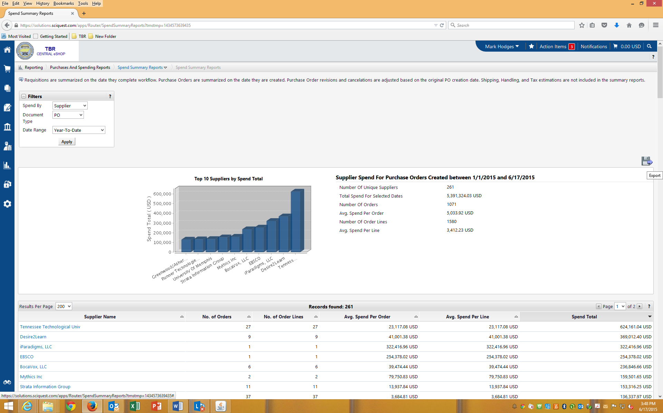
Click on Apply then Export

Slide 8
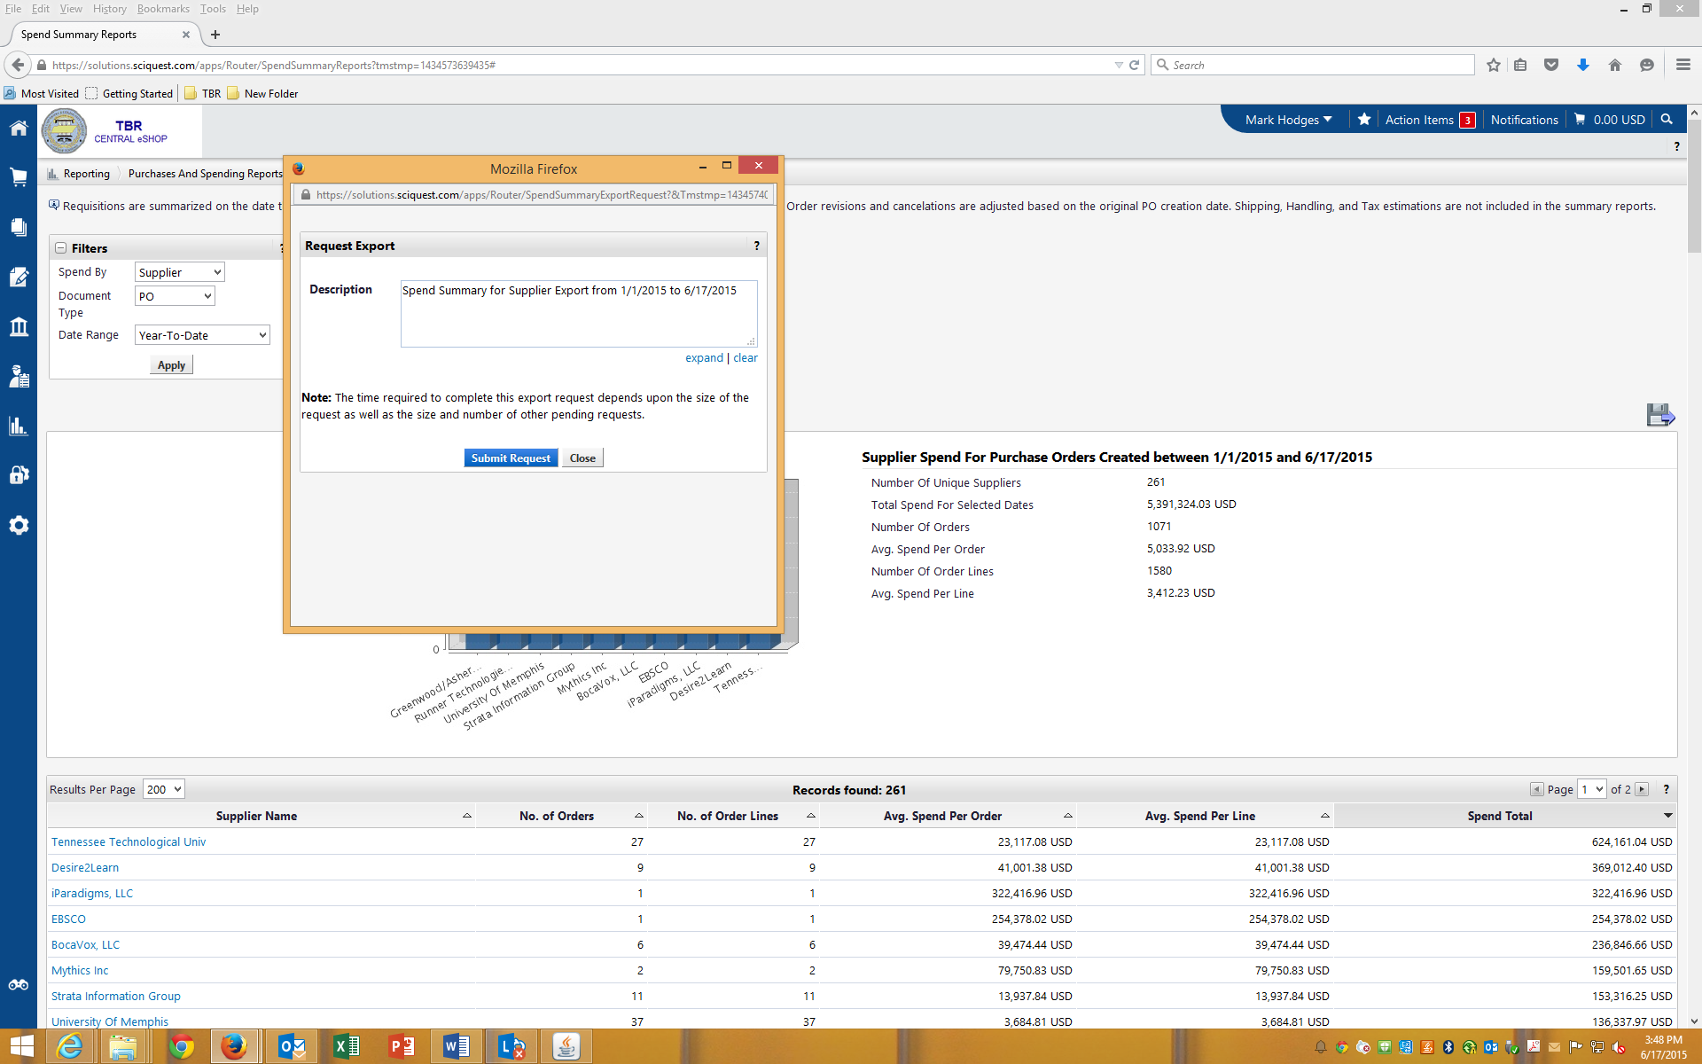
Click on Submit Request

Slide 9
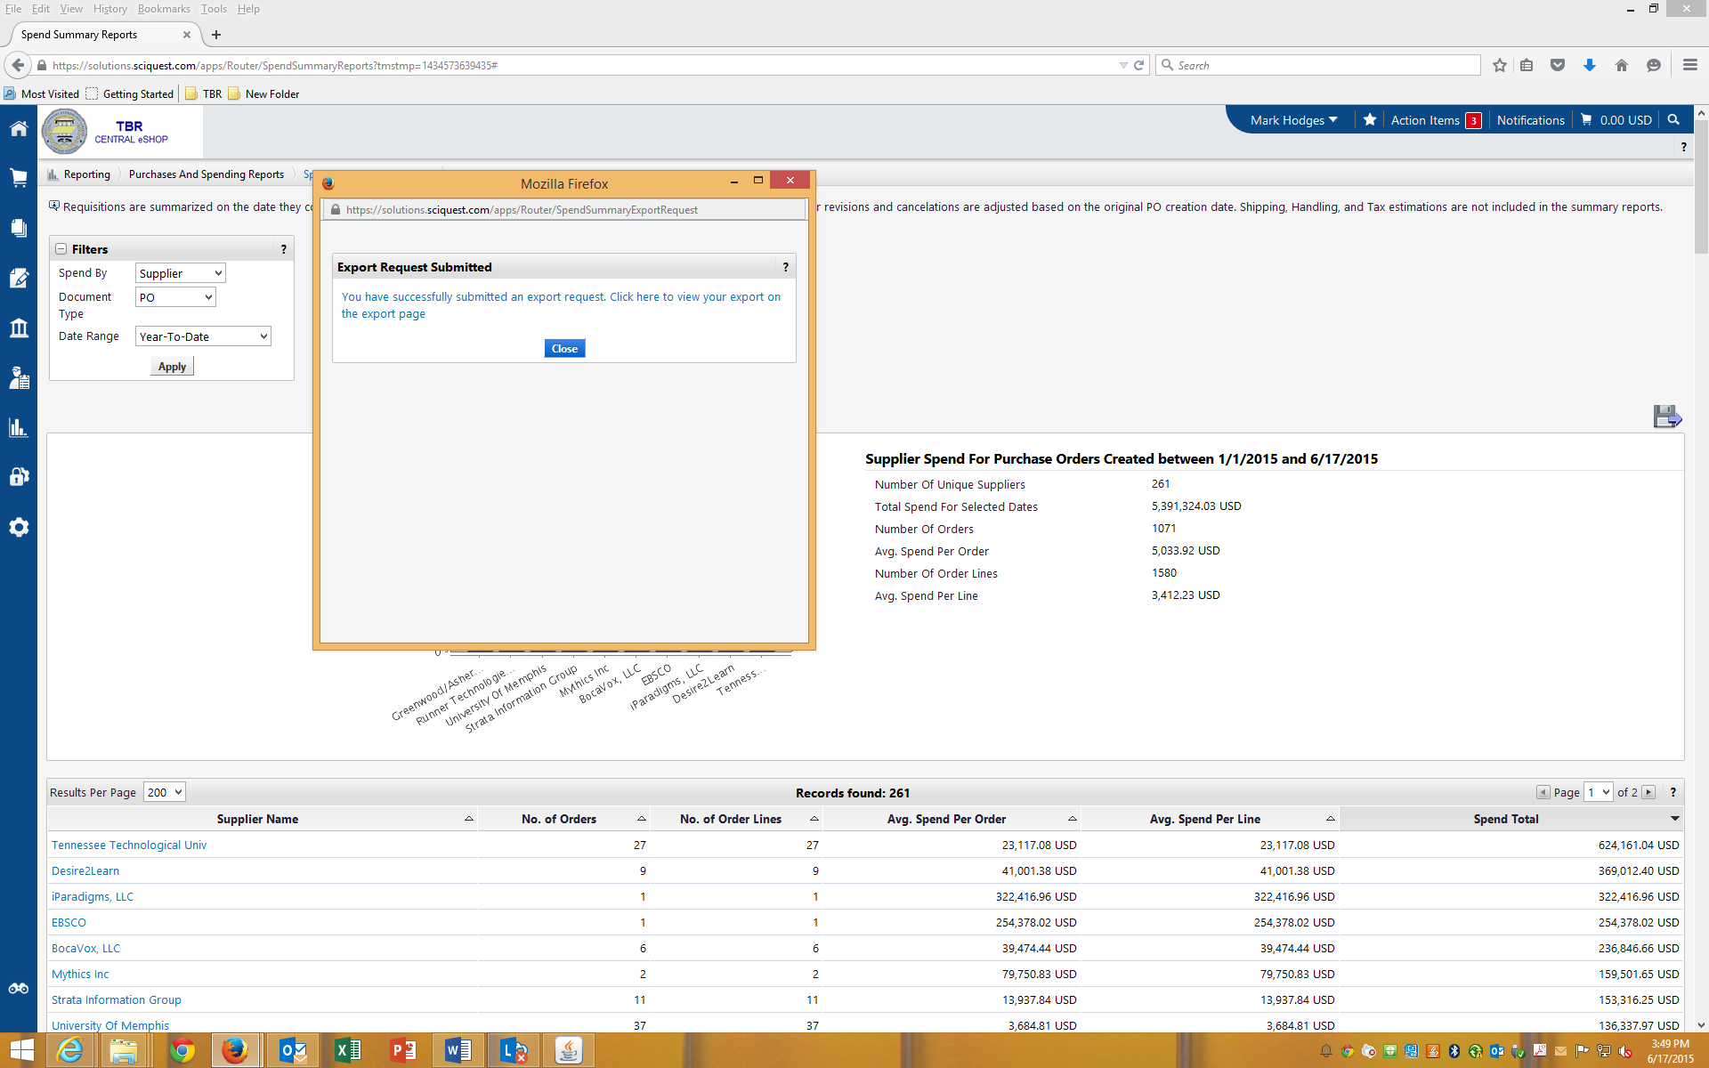
Click on Close

Slide 10
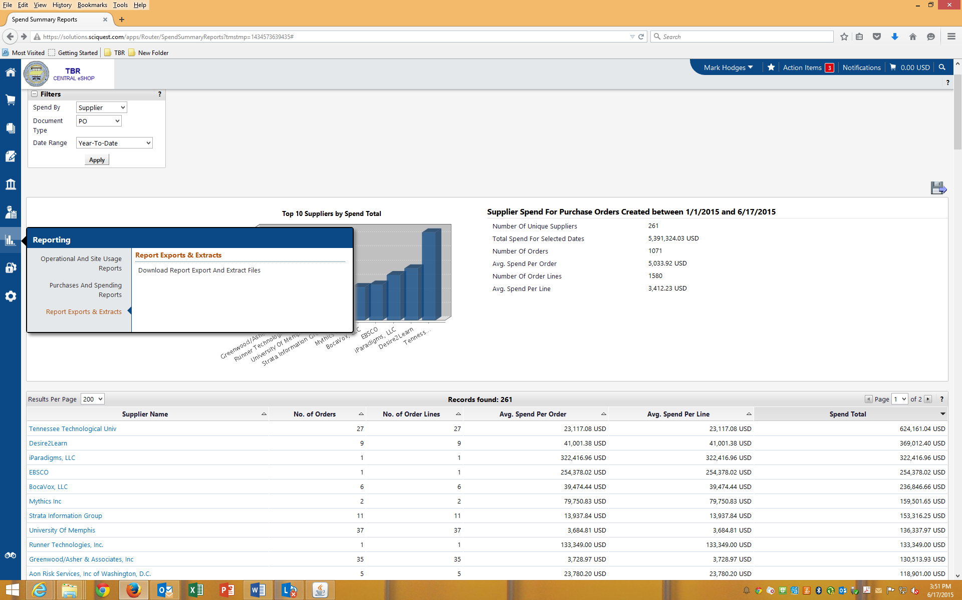
Click on Reporting->Report Exports and Extracts->Download Report Export & Extract Files

Slide 11
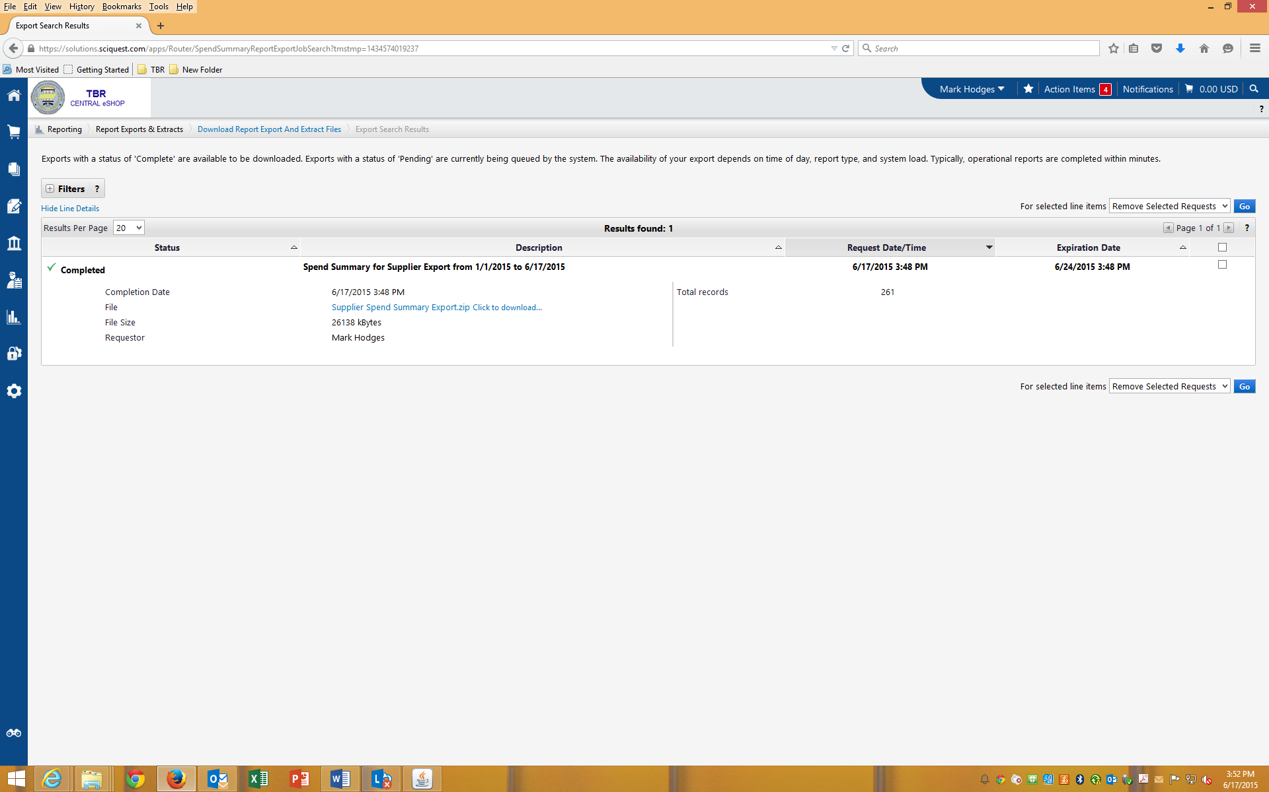
Click to Download

Slide 12
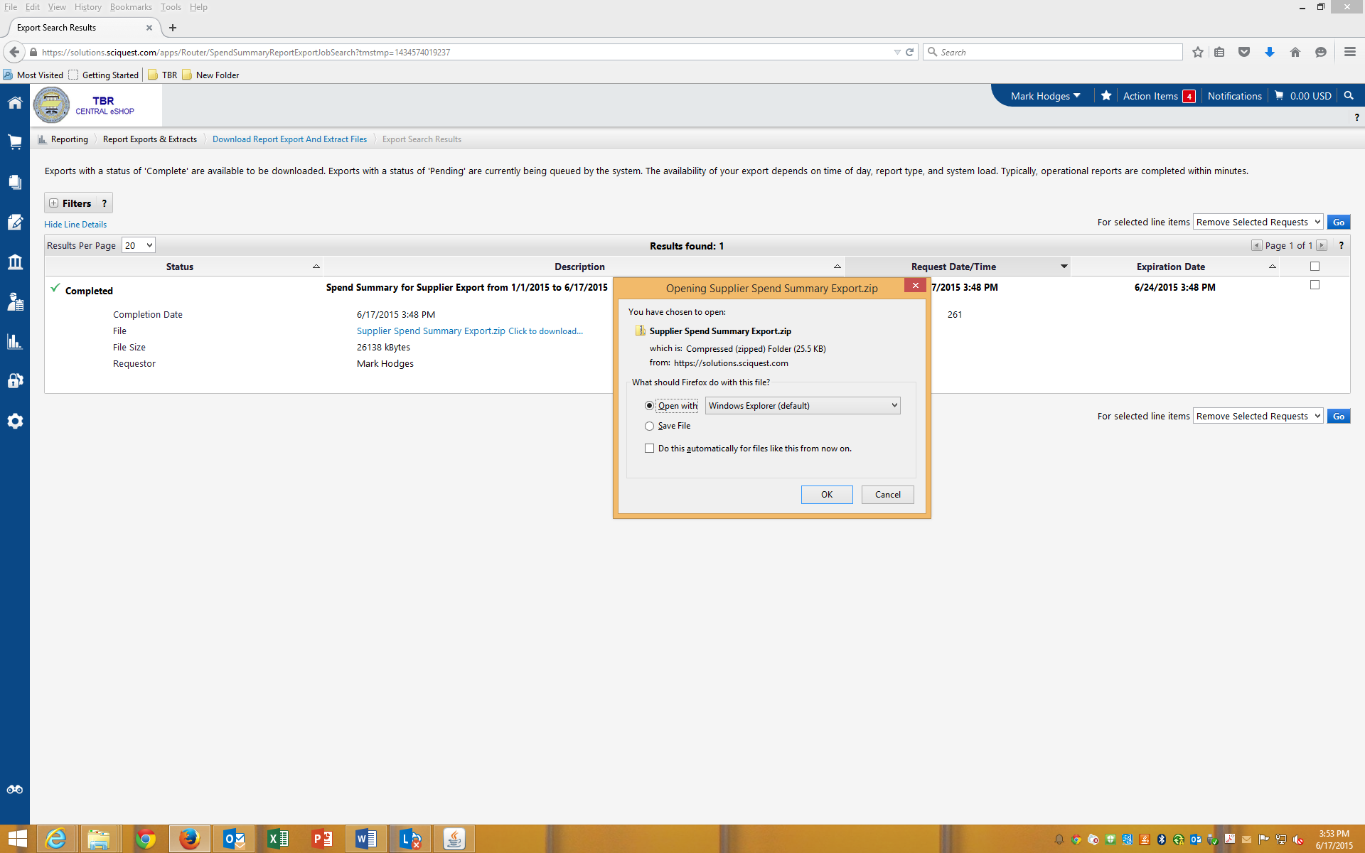
Click OK

Slide 13
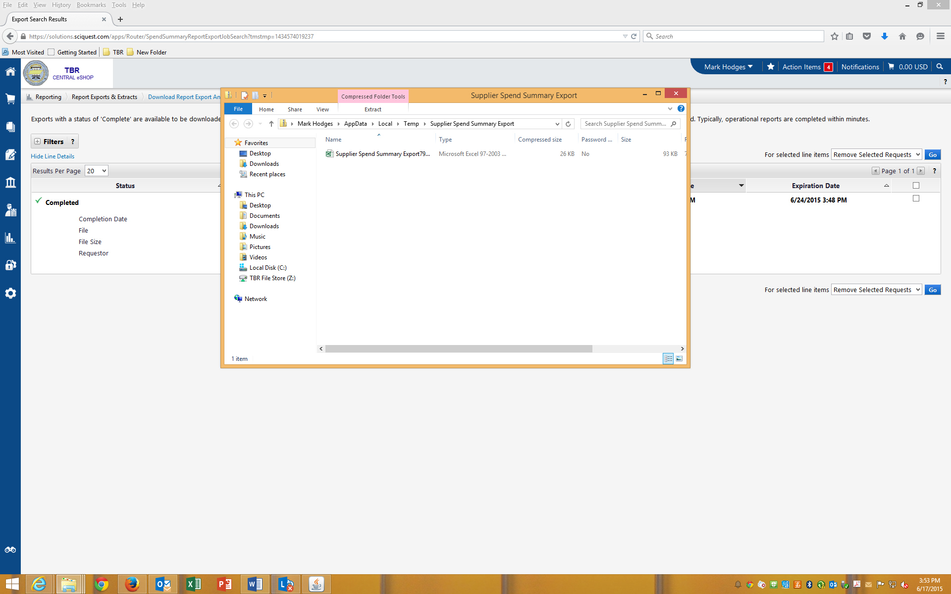
Click to Open

Slide 14
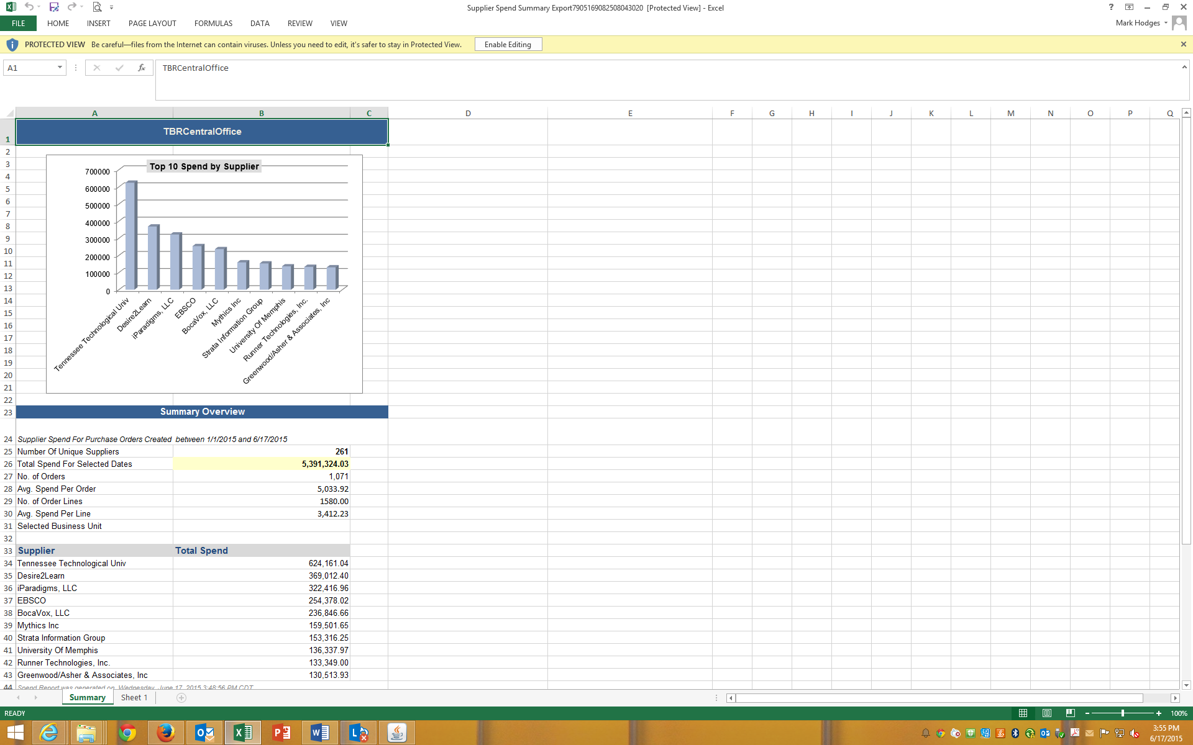
Sheet 1 of this Purchase and Spend Report by Organization.

Slide 15
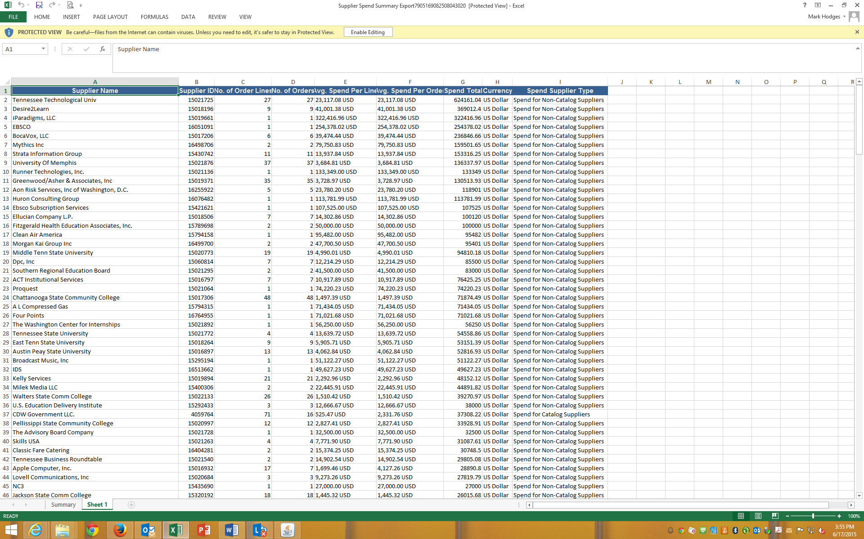
Sheet 2 of this Purchase and Spend Report by Organization.

Slide 16
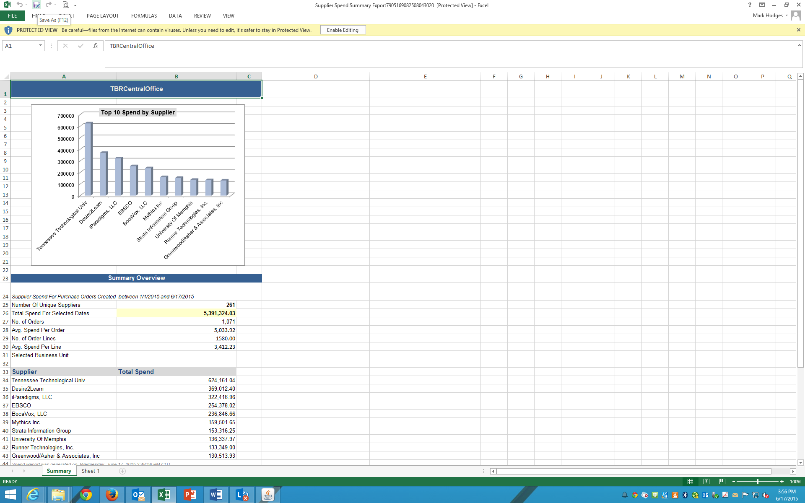
Save and name your file according to your institution and report type. As an example, this report would be named: TBR Systems Office Purchase and Spend Report by Organization. Email this file to: Angela.Flynn@tbr.edu; Mark.Hodges@tbr.edu; Anita.Jansen@tbr.edu

