Slide 1
Quarterly Board Meeting
Chattanooga State Community College
September 15, 2016

Slide 2
Committee on Workforce Development

Slide 3
Community College Graduates: Job Placement Rates and First-time Licensure Pass Rates
Vice Chancellor Warren Nichols

Slide 4
Job Placement Rates by Institution: 2014-2015 College Graduates
Institution | Total Placeable | Total Placed | Percent Placed
Chattanooga State Community College | 654 | 630 | 96%
Cleveland State Community College | 249 | 231 | 93%
Columbia State Community College | 278 | 242 | 87%
Dyersburg State Community College | 183 | 169 | 92%
Jackson State Community College | 321 | 301 | 94%
Motlow State Community College | 124 | 118 | 95%
Nashville State Community College | 334 | 310 | 93%
Northeast State Community College | 421 | 391 | 93%
Pellissippi State Community College | 388 | 366 | 94%
Roane State Community College | 414 | 402 | 97%
Southwest Tennessee Community College | 507 | 445 | 88%
Volunteer State Community College | 438 | 411 | 94%
Walters State Community College | 510 | 467 | 92%
Total | 4,821 | 4,483 | 93%
*2015-2016 THEC Fact Book

Slide 5
Job Placement Rates Community College Graduates Academic Years 2004-2005 through 2014-2015
Academic Year | Total Placeable | Total Placed | Percent Placed
2004-2005 | 4,081 | 3,746 | 92%
2005-2006 | 4,163 | 3,849 | 92%
2006-2007 | 3,996 | 3,726 | 93%
2007-2008 | 4,092 | 3,784 | 92%
2008-2009 | 3,702 | 3,415 | 92%
2009-2010 | 3,784 | 3,385 | 89%
2010-2011 | 3,916 | 3,645 | 93%
2011-2012 | 4,697 | 4,298 | 92%
2012-2013 | 4,597 | 4,200 | 91%
2013-2014 | 4,722 | 4,392 | 93%
2014-2015 | 4,821 | 4,483 | 93%
Total | 46,571 | 42,923 | 92%
*2015-2016 THEC Fact Book

Slide 6
Licensure Exam Pass Rates for Community Colleges 2014-2015 Nursing and Allied Health Programs First-time Test Takers
Institution | 2014 |  |  | 2015
 | Number Taken | Number Passed | Percent Passed | Number Taken | Number Passed | Percent Passed
Chattanooga State | 196 | 186 | 94.9% | 236 | 229 | 97.0%
Cleveland State | 67 | 54 | 80.6% | 104 | 73 | 70.2%
Columbia State | 156 | 140 | 89.7% | 166 | 149 | 89.8%
Dyersburg State | 133 | 103 | 77.4% | 79 | 67 | 84.8%
Jackson State | 196 | 182 | 92.9% | 171 | 159 | 93.0%
Motlow State | 61 | 53 | 86.9% | 65 | 63 | 96.9%
Nashville State | 54 | 47 | 87.0% | 48 | 45 | 93.8%
Northeast State | 58 | 46 | 79.3% | 32 | 28 | 87.5%
Pellissippi State | 36 | 35 | 97.2% | 76 | 68 | 89.5%
Roane State | 193 | 170 | 88.1% | 199 | 181 | 91.0%
Southwest Tennessee | 117 | 101 | 86.3% | 125 | 112 | 89.6%
Volunteer State | 78 | 72 | 92.3% | 65 | 58 | 89.2%
Walters State | 96 | 93 | 96.9% | 164 | 142 | 86.6%
*2015-2016 THEC Fact Book

Slide 7
Licensure Exam Pass Rates for Community Colleges 2014-2015 Nursing and Allied Health Programs First-time Test Takers
Institution | Exam | 2014 |  |  | 2015
 |  | Number Taken | Number Passed | Percent Passed | Number Taken | Number Passed | Percent Passed
Chattanooga State | Dental Hygiene | 19 | 18 | 94.7% | 19 | 19 | 100%
 | Physical Therapist Ast | 21 | 20 | 95.2% | 23 | 22 | 95.7%
 | Radiologic Technology | 26 | 26 | 100% | 23 | 23 | 100%
 | Respiratory Care | 13 | 12 | 92.3% | 22 | 22 | 100%
 | Nursing | 117 | 110 | 94.0% | 149 | 143 | 96.0%
Cleveland State | Nursing | 67 | 54 | 80.6% | 104 | 73 | 70.2%
Columbia State | Veterinary Technology | 20 | 12 | 60.0% | 15 | 10 | 66.7%
 | Radiologic Technology | 21 | 20 | 95.2% | 21 | 20 | 95.2%
 | Respiratory Care | 13 | 12 | 92.3% | 18 | 16 | 88.9%
 | Nursing | 102 | 96 | 94.1% | 112 | 103 | 92.0%
Dyersburg State | Health Information Tech | 14 | 12 | 85.7% | * | * | 83.3%
 | Nursing | 119 | 91 | 76.5% | 79 | 67 | 84.8%
*2015-2016 THEC Fact Book

Slide 8
Licensure Exam Pass Rates for Community Colleges 2014-2015 Nursing and Allied Health Programs First-time Test Takers
Institution | Exam | 2014 |  |  | 2015
 |  | Number Taken | Number Passed | Percent Passed | Number Taken | Number Passed | Percent Passed
Jackson State | Physical Therapist Ast | 24 | 21 | 87.5% | 19 | 18 | 94.7%
 | Radiologic Technology | 19 | 19 | 100% | 18 | 16 | 88.9%
 | Medical Lab Technology | 8 | 8 | 100% | 9 | 7 | 77.8%
 | Nursing | 145 | 134 | 92.4% | 125 | 118 | 94.4%
Motlow State | Nursing | 61 | 53 | 86.9% | 65 | 63 | 96.9%
Nashville State | Nursing | 36 | 29 | 80.6% | 27 | 26 | 96.3%
 | Occupational Therapy Ast | 18 | 18 | 100% | 21 | 19 | 90.5%
Northeast State | Nursing | 58 | 46 | 79.3% | 32 | 28 | 87.5%
Pellissippi State | Nursing | 36 | 35 | 97.2% | 76 | 68 | 89.5%
*2015-2016 THEC Fact Book

Slide 9
Licensure Exam Pass Rates for Community Colleges 2014-2015 Nursing and Allied Health Programs First-time Test Takers
Institution | Exam | 2014 |  |  | 2015
 |  | Number Taken | Number Passed | Percent Passed | Number Taken | Number Passed | Percent Passed
Roane State | Dental Hygiene | 11 | 11 | 100% | 10 | 10 | 100%
 | Occupational Therapy Ast | 17 | 13 | 76.5% | 17 | 17 | 100%
 | Physical Therapist Ast | 16 | 16 | 100% | 19 | 18 | 94.7%
 | Radiologic Technology | 26 | 25 | 96.2% | 27 | 25 | 92.6%
 | Respiratory Care | 9 | 6 | 66.7% | 13 | 13 | 100%
 | Nursing | 94 | 79 | 84.0% | 94 | 79 | 84.0%
 | Opticinary | 20 | 20 | 100% | 19 | 19 | 100%
Southwest Tennessee | Physical Therapist Ast | 22 | 18 | 81.8% | 18 | 15 | 83.3%
 | Radiologic Technology | 17 | 13 | 76.5% | 17 | 14 | 82.4%
 | Medical Lab Technology | 15 | 9 | 60.0% | 16 | 16 | 100%
 | Nursing | 63 | 61 | 96.8% | 74 | 67 | 90.5%
*2015-2016 THEC Fact Book

Slide 10
Licensure Exam Pass Rates for Community Colleges 2014-2015 Nursing and Allied Health Programs First-time Test Takers
Institution | Exam | 2014 |  |  | 2015
 |  | Number Taken | Number Passed | Percent Passed | Number Taken | Number Passed | Percent Passed
Volunteer State | Health Information Tech | 16 | 13 | 81.3% | * | * | 75.0%
 | Physical Therapist Ast | 22 | 19 | 86.4% | 29 | 23 | 79.3%
 | Radiologic Technology | 26 | 26 | 100% | 28 | 27 | 96.4%
 | Respiratory Care | 14 | 14 | 100% | 8 | 8 | 100%
Walters State | Physical Therapist Ast | 22 | 21 | 95.5% | 22 | 22 | 100%
 | Respiratory Care | 16 | 16 | 100% | 9 | 9 | 100%
 | Nursing | 58 | 56 | 96.6% | 133 | 111 | 83.5%
*2015-2016 THEC Fact Book

Slide 11
Proposed TCAT Program Terminations, Modifications, and New Technical Program Implementations

Slide 12
Implementations
Implementation of an Industrial Maintenance-Mechatronics program at TCAT-Livingston to be located at the Cookeville Higher Education Center;
Implementation of a Practical Nursing program at TCAT-Livingston to be located at the Cookeville Higher Education Center;
Implementation of a Welding Technology program at TCAT-Livingston to be located at the Cookeville Higher Education Center;
Implementation of a Welding Technology program at TCAT-McKenzie to be located at the Adult Education Building in Dresden, TN;

Slide 13
Highlight SkillsUSA National Awards

Slide 14
2016 SkillsUSA TCAT ANNUAL REPORT

Slide 15
https://youtu.be/98nuUd-t-P8

Slide 16
Tom Murray, Director of Marketing & Business Development Snap-on

Slide 17
Molly Martin, SkillsUSA State President

Slide 18
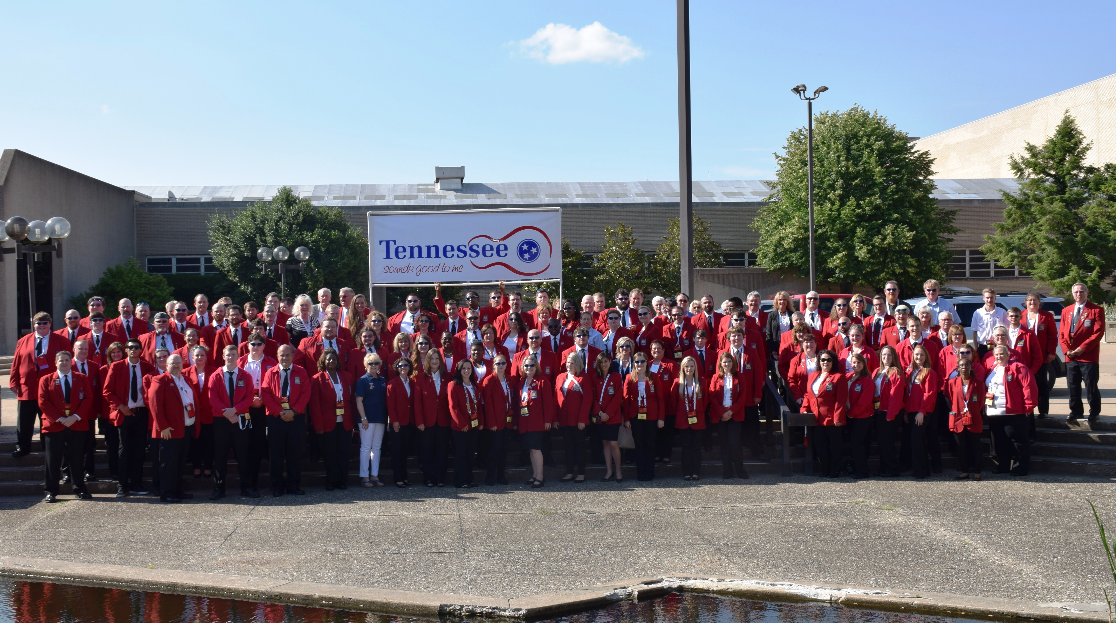
TCAT 2016 Delegation

Slide 19
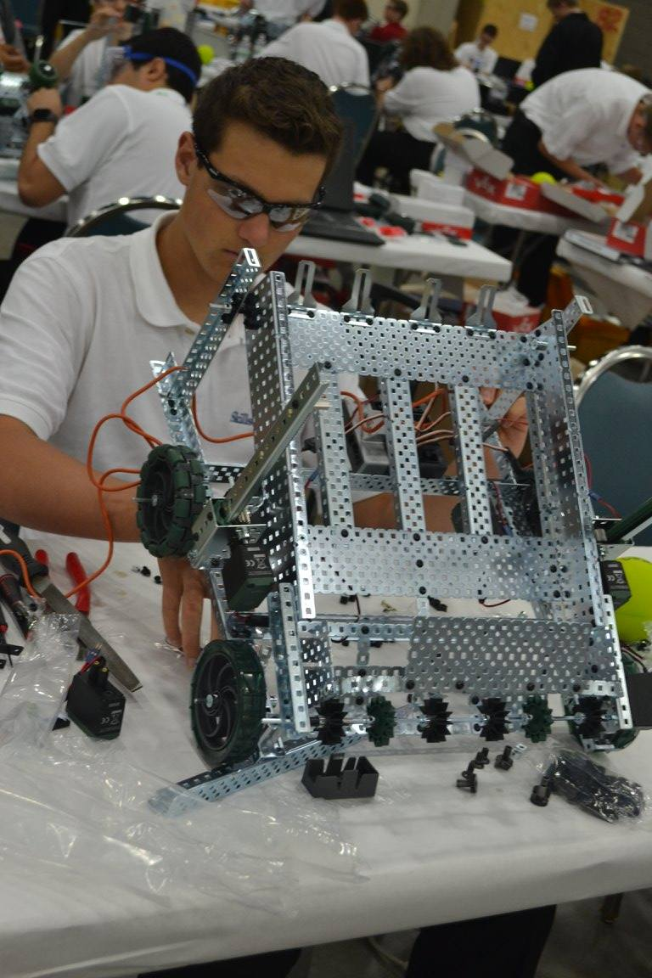
2016 SkillsUSA National Championship Floor

Slide 20
TCAT SkillsUSA National Champions
17 Gold Medals
12 Silver Medals
8 Bronze Medals

Slide 21
Sherrie Wilcox, SkillsUSA National Treasurer

Slide 22
2016 SkillsUSA TCAT ANNUAL REPORT

Slide 23
Committee on Academic Policies and Programs

Slide 24
Approval of New Degree Program Universities Dr. Tristan Denley Vice Chancellor, Academic Affairs
Middle Tennessee State University
Bachelor of Arts/Bachelor of Science (BA/BS) in Religious Studies

Slide 25
Academic Policy Revision Dr. Tristan Denley Vice Chancellor, Academic Affairs
TBR Policy 2:01:00:04
Awarding of Credits Earned Through Extra Institutional Learning to Community Colleges and Universities.

Slide 26
Annual Accreditation Report
Dr. Tristan Denley
Vice Chancellor, Academic Affairs

Slide 27
Institutional Accreditation
The UoM received reaffirmation of accreditation by the Southern Association of Colleges and Schools Commission on Colleges (SACSCOC) until 2025.
MTSU and TTU each submitted its self-study for off-site review and hosted a SACSCOC visiting team. A reaffirmation decision by SACSCOC for each institution will be rendered at the SACSCOC Annual Meeting in December 2016.
APSU submitted its Quality Enhancement Plan summary and monitoring report to SACSCOC.
TSU submitted its fifth-year interim report to SACSCOC.
JSCC received reaffirmation of accreditation by SACSCOC on June 16, 2016 until 2026.
Ten additional community colleges including Chattanooga State, Columbia State, Dyersburg State, Motlow State, Nashville State, Pellissippi State, Roane State, Southwest Tennessee, Volunteer State and Walters State were involved in activities related to the SACSCOC reaffirmation including substantive change, QEP and mid-cycle report processes.

Slide 28
Program Accreditation
Combined, TBR universities and community colleges have a total of 476 programs subject to accreditation by national agencies, 297 in TBR universities and 179 in community colleges.
88.3% of accreditable programs in TBR community colleges are fully accredited (158); 11.7% of accreditable programs are pending accreditation or are new programs seeking accreditation (21).
94.6% of accreditable programs in TBR universities are fully accredited (281); 5.4% of accreditable programs are pending accreditation or are new programs seeking accreditation (16).
In 2015-2016, TBR universities and community colleges participated in a total of 140 accreditation-related activities including self-studies, program reviews, site visits, and interim reports to accrediting agencies.
Of the 139 programs involved in some level of review by accrediting agencies, 33 programs received notice of an official action taken by the accrediting agency to include reaffirmation, continuation of accreditation, or acceptance as newly accredited in 2015-16.

Slide 29
Academic Audit and Program Review
For the 2015-16 academic year, 44 Academic Programs system-wide underwent the Academic Audit process.
In the spring of 2016, each of these programs completed an Academic Audit Self Study written report and hosted an Academic Auditor Team. The Academic Auditor Team provided an onsite review and subsequently issued a written report including commendations, affirmations and recommendations for improvement.
The TBR system had 36 programs undergo the Program Review process in 2015-16.
These programs each prepared a Program Review written report and hosted external peer reviewers on campus. These peer reviewers each subsequently prepared an evaluation and a written report.

Slide 30
Graduation Report
Dr. Tristan Denley
Vice Chancellor, Academic Affairs

Slide 31
Completion Agenda Goal and Trajectory
Graduates
Targets

Slide 32
Completion Agenda Goal and Trajectory
Bachelors Degrees
Graduates
Targets

Slide 33
Completion Agenda Goal and Trajectory
Associates Degrees
Graduates
Targets

Slide 34
Completion Agenda Goal and Trajectory
Community College Certificates
Graduates
Targets

Slide 35
Completion Agenda Goal and Trajectory
TCAT Diplomas
Graduates
Preliminary Graduates
Targets

Slide 36
Preliminary Productivity
9.5% increase
34% increase
Universities
Community Colleges

Slide 37
Preliminary Community College 3yr Graduation Rates
42% increase
74% increase
Notes:
42% increase, 74% for URM

Slide 38
Preliminary University 4yr Graduation Rates
24% increase
42% increase
Notes:
26% increase, 54% URM

Slide 39
Preliminary Fall Enrollment Report
Dr. Tristan Denley
Vice Chancellor, Academic Affairs

Slide 40
Fall Enrollment: Fall 2014 and Preliminary Fall 2015
0.7%
2.3%
2.4%
* Fall 2016 does not include session II enrollment at APSU’s Fort Campbell campus. ^ TCAT enrollment is from 10th day census reporting for fall 2014, 2015 and 2016.

Slide 41
Fall Enrollment Trend
* Fall 2016 does not include session II enrollment at APSU’s Fort Campbell campus.

Slide 42
First-time, Full-time Freshmen Recently Graduated from High School and Enrolled in TBR
* Fall 2016 does not include session II enrollment at APSU’s Fort Campbell campus.

Slide 43
Fall Enrollment Age 25+ vs TN Unemployment rate
* Fall 2016 does not include session II enrollment at APSU’s Fort Campbell campus.

Slide 44
Enrollment By Student Level: Universities
Fall 2016 does not include session II enrollment at APSU’s Fort Campbell campus.

Slide 45
Enrollment By Student Level: Community Colleges

Slide 46
Report on Academic Affairs Initiatives
Dr. Tristan Denley
Vice Chancellor, Academic Affairs

Slide 47
Health Professions
Academic Foci
Applied
Technology
STEM
Humanities
Business
General Education
Social Sciences
Arts
Education

Slide 48
Community College Graduation Rates
1st yr - Did not attempt 9hrs in focus area
1st yr - Attempted 9hrs in focus area
1st yr - Earned 9hrs in focus area

Slide 49
University Graduation Rates
1st yr - Did not attempt 9hrs in focus area
1st yr - Attempted 9hrs in focus area
1st yr - Earned 9hrs in focus area

Slide 50
Incoming Freshmen who successfully completed at least 9 hours in their focus
during their 1st Academic Year
81% increase
56 % increase

Slide 51
Incoming Minority Freshmen who successfully completed at least 9 hours in their focus
during their 1st Academic Year
89 % increase
93 % increase

Slide 52
Completion of Gateway Math by ACT Sub-score Community College Pre-requisite Model vs. Co-requisite Model
9479 Students
7422 Students

Slide 53
Completion of Gateway English by ACT Sub-score
6071 Students
7147 Students

Slide 54
Community College Graduation Rates
1st yr - Did not pass all 3 courses
1st yr - Passed all 3 courses
Freshmen completion of:
English Composition I
English Composition II
A General Education satisfying Math Class

Slide 55
University Graduation Rates
1st yr - Did not pass all 3 courses
1st yr - Passed all 3 courses
Freshmen completion of:
English Composition I
English Composition II
A General Education satisfying Math Class

Slide 56
Incoming Freshmen who successfully completed their Math and Writing
requirements in their 1st Academic Year
79% increase
11% increase

Slide 57
Incoming Minority Freshmen who successfully completed their Math and Writing
requirements in their 1st Academic Year
24% increase
240% increase

Slide 58
Committee on Personnel and Compensation
September 2016

Slide 59
Committee on Personnel and Compensation
Consent Agenda
Out of Cycle Tenure and Promotion at Chattanooga State
Recommendations to Award Tenure upon Appointment
2. Consideration of Compensation Proposals
3. Revisions to TBR Policy 7:01:00:00 Firearms and Other Weapons

Slide 60
Consent Agenda (Vice Chancellor Denley)
Out of Cycle Tenure and Promotion at Chattanooga State
Recommendations to Award Tenure Upon Appointment

Slide 61
Consideration of Compensation Proposals (Vice Chancellor Sims)
In June the Board authorized the submission of proposed institutional salary plans.
Institutions were given the flexibility to supplement the excess outcome funding with local sources to provide additional salary increases or address personnel needs.

Slide 62
Consideration of Compensation Proposals
Strategies Approved for Increases:
Compensation Plan
Institutions may provide salary adjustments consistent with their Board Approved compensation plans and/or
Institutions may adjust the salary ranges to address changes in market salaries as prescribed in their compensation plan and/or
Institutions may address specific equity issues and reclassifications consistent with their compensation plan and/or
Cost of Living Adjustment (COLA)
Institutions may provide a COLA, based on salaries as of June 30, 2016 with the amounts being pro-rated for part-time employees and/or
Faculty Promotions
Institutions may use all or a portion of the funding to fund the faculty promotions, consistent with the institution’s approved compensation plan.

Slide 63
Consideration of Compensation Proposals (continued)
One-Time Payment
Institutions may provide a one-time payment to all regular full-time and part-time employees on payroll as of June 30, 2016. One-time payments for part-time employees shall be pro-rated;
Funding Additional Positions
Institutions may fund the creation of new positions. Positions would be funded from the requested salary pool, based on institutional needs

Slide 64
Proposed Compensation Increase Summary Note: An Institution may choose multiple strategies
Requested Action | Universities | Community Colleges | TN Colleges of Applied Technology | System Office | Total
Compensation Plan | 5 | 10 | 1 | 1 | 17
Cost of Living Allowance (COLA) | 5 | 8 | 1 | 0 | 14
Faculty Promotions | 2 | 3 | 0 | 0 | 5
One-Time Payment | 2 | 5 | 0 | 0 | 7
Additional Positions | 0 | 2 | 0 | 0 | 2
Total | 14 | 28 | 2 | 1 | 45

Slide 65
Compensation Strategy Funding

Slide 66
Breakdown of Recurring Salary Adjustments

Slide 67
Revisions to TBR Policy 7:01:00:00 – Firearms and other Weapons (General Counsel Mary Moody)

Slide 68
Committee on Personnel and Compensation

Slide 69
Committee on Finance and Business Operations
September 2016

Slide 70
Committee on Finance and Business Operations September 15, 2016
Consent Agenda
Approval of New Policy 1:10:00:00 – Contracts
Recommended Revisions to Policy 1:03:02:10 – Approvals of Procurements and Contracts
Approval of New Policy 4:02:10:10 – Procurement Card
Technology Access Fee Spending Plans
Presentation of Capital Budget for FY 2017-2018
Capital Budget Request
University of Memphis Project Substitution
Matching Funds Summary for Recommended Projects
System Budget Requests to Tennessee Higher Education Commission

Slide 71
Consent Agenda
Approval of New Policy 1:10:00:00 – Contracts
Recommended Revisions to Policy 1:03:02:10 – Approvals of Procurements and Contracts
Approval of New Policy 4:02:10:10 – Procurement Card
Technology Access Fee Spending Plans

Slide 72
Summary of Capital Budget Request 2017– 2018 of the Tennessee Board of Regents
September 15, 2016

Slide 73
Classifications of Projects
Capital Outlay
Capital Maintenance
Disclosures
slide 2
See page 2 in booklet

Slide 74
Capital Outlay Prioritization Formula
Type of Space . . . . . . . . . . . . . . . . . . . . . . 35 points
favors core academics
Composite Shortage . . . . . . . . . . . . . . . . . 35 points
weighs space shortfall by function and utilization
Functionality & Quality . . . . . . . . . . . . . . 30 points
evaluates space where existing program requirements are least functional
CCTA
brief narrative supporting Complete College Tennessee Act.
slide 3
See page 4 in booklet

Slide 75
Capital Outlay Request
Funding is for University projects 1 – 3, and Community College and TCAT projects 1 -9
slide 4
See page 5 in booklet
This Request $ 294,680,000

Slide 76
Capital Maintenance Target Funding
Adjusted E & G Gross Square Footage | 25,952,079
Replacement Cost | $ 6,455,436,320
Target Funding | $ 119,552,058
FY 17/18 Funding Request Priority by Type | $116,450,000
1) Building Codes & Safety
2) Roofs
3) Mechanical & Infrastructure
4) Building Envelope
5) Interiors and Finishes
slide 5
See page 8 in booklet

Slide 77
Capital Maintenance Request
$ 116,450,000 in 80 projects | Annual Renewal on pages 9 – 11
$ 94,430,000 in 55 projects | Unmet Needs
$ 210,880,000 | Total
slide 6
See pages 9-11 in booklet

Slide 78
Project Disclosures
20 projects
Austin Peay State University
Tennessee State University
University of Memphis Motlow State Community College
Northeast State Community College Pellissippi State Community College
Roane State Community College
Volunteer State Community College
slide 7
See page 14
in booklet

Slide 79
Capital Budget Five Year Plan
 | Outlay | Maintenance | Total
FY 17/18 | 294,680,000 | 116,450,000 | 411,130,000
FY 18/19 | 150,000,000 | 43,490,000 | 193,490,000
FY 19/20 | 150,000,000 | 45,670,000 | 195,670,000
FY 20/21 | 150,000,000 | 47,960,000 | 197,960,000
FY 21/22 | 150,000,000 | 50,350,000 | 200,350,000
Total | 894,680,000 | 303,920,000 | 1,198,600,000
slide 8
See page 15 in booklet

Slide 80
Capital Outlay Potential Out-Year Projects
Institutional 1st Priorities (Community College & TCAT projects) | 8 projects
Institutional 2nd Priorities (Community College & TCAT projects) | 1 projects
Total Estimated Cost | $ 118,160,000
slide 9
See page 16 in booklet

Slide 81
Summary of the Capital Budget Request
 |  |  | This Request
Outlay |  | Standard Projects | 294,680,000
Maintenance |  | Annual Renewal | 116,450,000
Total |  | Outlay + Maintenance | 411,130,000
slide 10
See page 17 in booklet

Slide 82
Summary of Capital Budget Request 2017– 2018 of the Tennessee Board of Regents
September 15, 2016
slide 11

Slide 83
University of Memphis Substitution Request
Request to Substitute Music Center for Biochemistry & Biology Building
Factors Not Considered in Staff Analysis
Campus Priority
Match Availability
Donor Issues
FOCUS Act Implications
Risk to Other Projects

Slide 84
Matching Funds Plans Projects Recommended for FY 2017-18

Slide 85
TBR System Budget Request FY 2017-18

Slide 86
Committee on Finance and Business Operations
September 2016

Slide 87
Quarterly Board Meeting
Chattanooga State Community College
September 15, 2016

