Slide 1
Quarterly Board Meeting
Roane State Community College
June 22, 2017

Slide 2
Committee on Finance and Business Operations
June 22, 2017

Slide 3
Consent Agenda
Approval of the Minutes from the April 13 and May 18, 2017 Special Called Meetings of the Finance and Business Operations Committee

Slide 4
Action Items
Approval of Recommendations on Mandatory Fees, Maintenance Fees and Tuition
Approval for Funding of Operations for the FY 2016-17 Estimated Budget and the FY 2017-18 Proposed Budget

Slide 5
Action Item A
Approval of Recommendations on Mandatory Fees, Maintenance Fees and Tuition

Slide 6
Mandatory Fee Requests

Slide 7
COSCC Project Description
Summary
Construction of Phase 1 of a parking facility that will provide 248 additional parking spaces
Phase 1 will meet the anticipated short term needs of the campus
Parking facility can be expanded in future by adding 2 decks

Slide 8
COSCC – Funding of Debt Service
Proposal:
Size student fee to meet expected debt service need @ 4% interest
Pledge additional institutional revenues to meet TSSBA pro forma requirement of 7% (@ 20 year financing)
Institution acknowledges that it will be responsible for debt service cost if eventual debt carries rate above 4%

Slide 9
COSCC Request Effect on Mandatory Fees (annual)

Slide 10
Recommended Action
Approve COSCC debt service fee at $22 per semester
COSCC pledges additional institutional funds to meet TSSBA pro forma requirements
Allows parking garage project to proceed as originally planned in size and scope

Slide 11
Indicated Student Revenue Increases

Slide 12
Community Colleges: Indicated Student Revenue Increase

Slide 13
Colleges of Applied Technology Indicated Student Revenue Increase

Slide 14
Recommended Maintenance Fee and Tuition Rates

Slide 15
Community Colleges

Slide 16
Colleges of Applied Technology

Slide 17
Summary Indicated Student Revenue Increase

Slide 18
Combined Fee Impact on Student Engaged in 30 Credit Hours Annually (1)

Slide 19
Recommended Actions
Approve recommended mandatory fee change for Columbia State Community College as presented in transmittal and shown on slide 9.
Approve recommended maintenance fee and tuition rates as presented in transmittal and shown on slides 14 and 15.

Slide 20
Action Item B
Consideration of Recommended Budgets
FY 2016-17 Estimated Budget
FY 2017-18 Proposed Budget
Notes:
These are the first budgets considered by Board under full operation of the FOCUS Act
Unlike in past, detailed tables in presentation will only include information on colleges, TCATs, and System Office
At end of presentation will be requesting two actions approving budgets –
Colleges, TCATS, & System Office
Universities

Slide 21
Approval of the Estimated Budget 2016-17 Fiscal Year
The Estimated Budget is the final approved budget for the fiscal year
Recognizes factors such as enrollment increases throughout the year, the level of grant activity, or final adjustments required by state budget action
At year-end close, actual expenses are compared to the Estimated Budget to determine favorable / unfavorable budget variances

Slide 22
Approval of the Proposed Budget 2017-18 Fiscal Year
Approval of the Proposed Budget provides the System with budgetary operating authority for the year beginning July 1, 2017
Proposed Budget does not recognize factors such as enrollment increases, level of grant or revenue contract activity, or final adjustments required by state budget action
The Revised Budget presented to Board in December will take these and other changes into account

Slide 23
Where the Money Comes From and What it Pays for: 2017-18 Proposed Budget
Fees and Appropriations
Comes From: State appropriations Maintenance Fees & Tuition Mandatory & incidental fees Pays for: Instruction Public service Academic support Student services Institutional support Plant operation Scholarships
Sales / Services / Other
Comes From: Service assessments Investment Income Private Gifts | Pays for: Instruction Public service Academic support Student services Institutional support Plant operation Scholarship

Slide 24
Where the Money Comes From and What it Pays for: 2017-18 Proposed Budget
Restricted Funds
Comes From: Federal and state student assistance Grants and contracts Endowment income Gifts Pays for: Instruction Scholarships Public service
Auxiliary Funds
Comes From: Bookstore Food Services | Pays for: All expenses Receive no taxpayer or tuition support

Slide 25
Revenues: Comparison of Estimated and Proposed Budgets

Slide 26
Reconciliation of State Appropriation

Slide 27
Revenue Sources by Sector

Slide 28
Unrestricted E & G: Expenditures by Function
Notes:
Transfers to the unexpended plant fund decreased $11.9 million, primarily at PSCC, NESCC, and WSCC. In the Estimated budget, PSCC and WSCC were able to set aside funds for various initiatives. These set-asides are not anticipated to be available again during FY 2018. NESCC transferred $2.9 million in the Estimated budget to close out four capital projects. This type transfer will not be needed for FY 2018.
TBR transferred $31.6 million to R&R funds in the Estimated budget, primarily due to the non-recurring appropriation for the community college shared services project of $28.7 million.

Slide 29
Unrestricted E & G: Expenditures by Natural Classification
Notes:
The increase in capital equipment occurred primarily at NASCC. NASCC is planning to expand the Health Care laboratory used by the following programs: nursing, surgical tech, and occupational therapy.
Transfers to the unexpended plant fund decreased $11.9 million, primarily at PSCC, NESCC, and WSCC. In the Estimated budget, PSCC and WSCC were able to set aside funds for various initiatives. These set-asides are not anticipated to be available again during FY 2018. NESCC transferred $2.9 million in the Estimated budget to close out four capital projects. This type transfer will not be needed for FY 2018.
TBR transferred $31.6 million to R&R funds in the Estimated budget, primarily due to the non-recurring appropriation for the community college shared services project of $28.7 million.

Slide 30
Transfer Activity Summary
Notes:
Transfers to the unexpended plant fund decreased $11.9 million, primarily at PSCC, NESCC, and WSCC. In the Estimated budget, PSCC and WSCC were able to set aside funds for various initiatives. These set-asides are not anticipated to be available again during FY 2018. NESCC transferred $2.9 million in the Estimated budget to close out four capital projects. This type transfer will not be needed for FY 2018.
TBR transferred $31.6 million to R&R funds in the Estimated budget, primarily due to the non-recurring appropriation for the community college shared services project of $28.7 million.

Slide 31
FY 2017-18 Proposed Budget Unrestricted Funds Available & Applied

Slide 32
FY 2017-18 Proposed Budget: Authorized Positions

Slide 33
Consideration of College, TCAT, & System Office Budgets
Notes:
This table summarizes the materials included in Board materials related to budgets for colleges, TCATs, and the System Office
Board materials also include information on university budgets
Action recommended is to approve
As part of approval of the Proposed Budgets for FY 2017-18, staff recommends that the Board authorize the Chancellor to take actions necessary to implement the approved budgets.

Slide 34
Consideration of University Budgets
University budgets have been received and reviewed in accordance with TBR Policy 4:01:00:05, Consideration of University Budgets
University budgets have been determined to meet debt service coverage requirements;
University budgets have been found to be mathematically correct and internally consistent;
Universities have certified compliance with required representations; and
Except as noted above, no judgments have been made regarding university budgets.
Universities budgets are recommended for approval as being in compliance with the above TBR policy
Notes:
Board materials include more detailed information on university budgets as approved by the local board of trustees

Slide 35
End of Materials

Slide 36
Committee on Personnel and Compensation
June 22, 2017

Slide 37
Consent Agenda
Tenure and Promotion Recommendations at Community Colleges
Tenure and Promotion Recommendations at Tennessee Colleges of Applied Technology
Review and Approval of Faculty Promotional Increases
Review of Institutional Requests for New or Amended Compensation Plans

Slide 38
System Wide Compensation Strategy
The proposal attempts to address the collective compensation issues identified by the institutions, while offering consistence & flexibility.
The recommended System Wide Compensation Strategy includes:
A salary pool would be created of 3% of salaries of all regular, full and part-time benefit eligible employees, restricted and unrestricted, on the payroll as of June 30, 2017. This salary pool would be used for the following purposes:
Mandatory COLA of 1.7% for all regular, full and part-time benefit eligible employees, restricted and unrestricted effective July 1, 2017; and
Subject to institutional requests and Board approval, the remaining salary pool may be used for following purposes:
Supplemental COLA of 1.3%; or
Compensation Plan improvements & adjustments; or
Faculty Promotions.
Locally funded Adjustments: Institutions would be authorized to provide salary adjustments consistent with those mentioned above, as well as a One-Time Payment option, using uncommitted local funds. The institution will submit the effective date of payment with the proposal for review at the September Board Meeting.

Slide 39
System Wide Compensation Strategy Continued
Process:
Payment of 1.7% COLA effective July 1, 2017
Payment of supplemental COLA of 1.3% effective July 1, 2017 based on institutional requests
Institutions submit proposals to staff by August 16th related to use of remaining 1.3% salary pool or for locally funded requests
Board staff review, clarify, and summarize proposals.
Institutional proposals submitted to the Committee and Board for consideration during September Board meeting.

Slide 40
System Wide Compensation Strategy continued
Institutions Providing 3% COLA
Institutions Providing 1.7% COLA
Chattanooga State
Cleveland State -TCATs
Columbia State -System Office
Dyersburg State
Motlow State
Nashville State
Pellissippi State
Southwest State
Walters State
Jackson State
Northeast State
Roane State
Volunteer State

Slide 41
System Wide Compensation Strategy Recommended Action
Approve System Wide Compensation Strategy as presented, including:
Approval of the System Wide 1.7% COLA, effective July 1, 2017; and
Approval of supplemental 1.3% COLA, effective July 1, 2017, for those institutions that have requested such action; and
For institutions not electing to request a supplemental COLA, authorize the submission of proposals for use of the remaining 1.3% salary pool consistent with the purposes outlined in the Board transmittal; and
Authorize institutions to submit requests for uses of local funds for compensation purposes, consistent with the purposes outlined in the Board transmittal.

Slide 42
Executive Incentive Compensation Plan Payments
The Executive Performance Incentive Plan was approved in June 2013.
Allows a one-time payment incentive amount up to or equal to 10% of the market average salary for comparable positions.
Two components
Metric Based (85% of the 10% total): tied to the 11 outcome measures used in funding colleges and to 5 specific metrics for TCATs
Discretionary Allowance (15% of the 10% total): based on factors outside those enumerated within the metric based allowance
Recommended Action
Approve metric based payments as recommended in Board transmittal

Slide 43
President Emeritus Contracts
Per requirements to be compensated as president emeritus (T.C.A. § 8-36-714) and TBR Policy 5:01:03:00 Retirement, persons serving as President Emeritus must file a report for the previous year’s work (approved by the sitting President), and a copy of the contract for the next fiscal year’s work, for approval by the board.
Attached are the reports and contracts for approval for fiscal year 2017-18.

Slide 44
Appointments Reporting to the Chancellor
Recommended for Approval
Interim Vice Chancellor for Student Success - Dr. Heidi Leming
Executive Vice Chancellor for Policy & Strategy – Dr. Russ Deaton
Informational Only
Special Assistant to the Chancellor – Dr. Lynn Goodman

Slide 45
An Overview of System Office Equity Practices
TBR Personnel Committee
June 22, 2017

Slide 46
What is Equity?

Slide 47
What Do We Mean When We Say – Equal Opportunity?

Slide 48
What Do We Mean When We Say – Affirmative Action?

Slide 49
Equality
Treating everyone the same.

Slide 50
Equity
Intentional efforts to provide equal opportunity.

Slide 51
How We Do It
Training
Advising
Monitoring
Reporting

Slide 52
Questions?

Slide 53
Committee on Personnel and Compensation
June 22, 2017

Slide 54
Committee on Academic Policies and Programs and Student Life
June 22, 2017

Slide 55
Approval of New Degree Program
Chattanooga State Community College
Associate of Applied Science in Nuclear Medicine Technology (A.A.S.)

Slide 56
Proposed TCAT Program Terminations, Modifications, and New Technical Program Implementations

Slide 57
Implementations
Retail, Hospitality, and Tourism Technology at TCAT-Jackson to be located at the Lexington Extension Campus
Health Information Management Technology at TCAT-Jackson
Aesthetics Technology at TCAT-Hohenwald
Cosmetology at TCAT-Chattanooga to be located at Grundy County High School
Certified Nursing Assistant at TCAT-Crossville
Barbering at TCAT-Chattanooga

Slide 58
Proposed Revisions to TBR Policy 2:03:01:05 – Academic Retention and Readmission at the Tennessee Colleges of Applied Technology

Slide 59
Committee on Academic Policies and Programs and Student Life
June 22, 2017

Slide 60
Committee on External Affairs
June 22, 2017

Slide 61
New Role of Office of External Affairs Office Post-FOCUS Act
Dr. Kim McCormick
Vice Chancellor

Slide 62
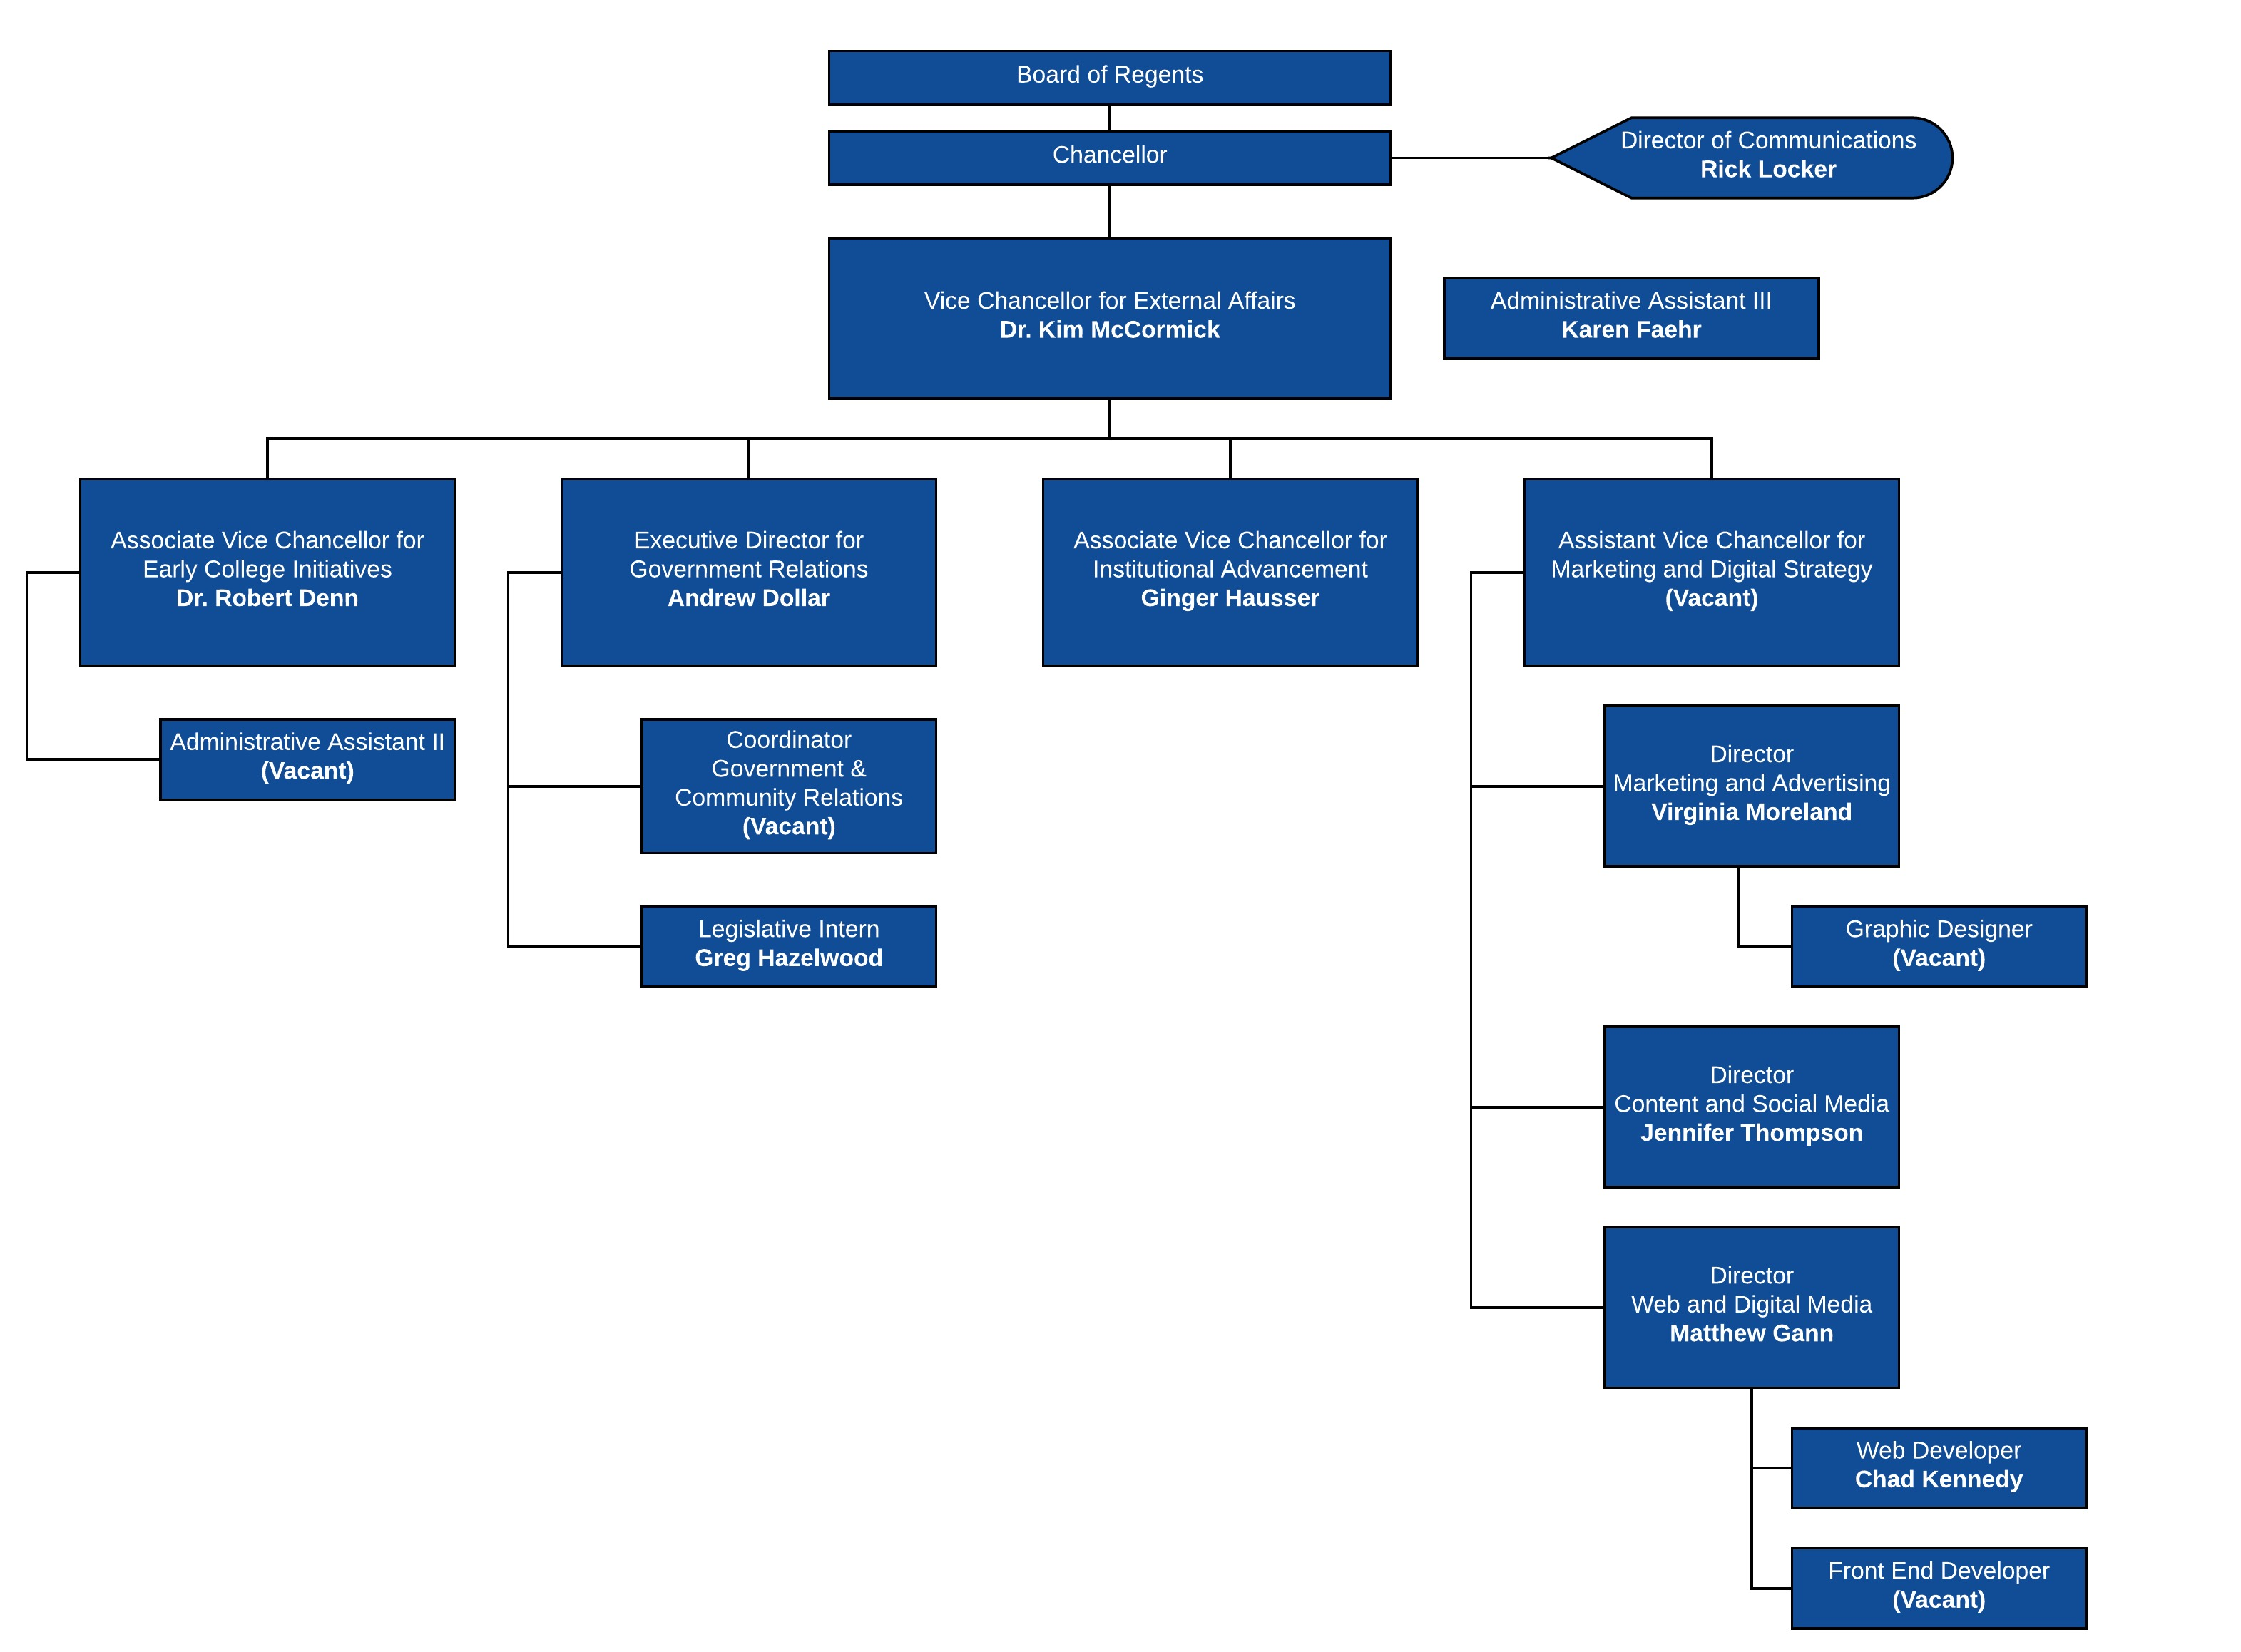

Slide 63
K-12 Initiatives
Dual Enrollment/Dual Credit
Department of Education Collaboration
SAILS TN

Slide 64
Government Relations
Enhance TBR’s relationship with elected officials, agencies, and organizations.
Design, promote, and implement a comprehensive TBR legislative agenda.
Develop innovative public policy to support higher education and workforce development.
Establish a statewide advocacy network.
Conduct ourselves in a highly visible, responsive, and ethical manner.

Slide 65
Institutional Advancement
Lead system fundraising, foundation and corporate relationship development, community relations and federal grant partnerships
Support campus advancement efforts: fundraising, alumni relations, special events, grant and community partnerships
Create system network for campus advancement and grant development staff

Slide 66
Marketing and Digital Strategy
Customer and Data Driven Strategies
Targeted Campaigns with Traditional and Digital Media
Enhance TBR Brand from “governing board” to “The College System of Tennessee”
Promote Quality Academic and Training Programs, Both Online and On-Campus
Strengthen Relationships and Collaborations Among Our Colleges
Develop Strategic Outreach Programs for Targeted Audiences such as Veterans and Underserved Communities
Emphasize Economic Impact of Our System and Our Colleges
Provide Value for Our Colleges and Our State

Slide 67
Our Focus is Student Success
Our goal is to be the best community and technical college system in the country

Slide 68
Committee on External Affairs
June 22, 2017

Slide 69
Committee on Workforce Development
June 22, 2017

Slide 71
Office of Economic and Community Development Mission
The mission is to collaborate with business, industry and government agencies to develop and deliver customized rapid response programs that provide training for workforce skills that are defined for an organization’s success.

Slide 72
Office of Economic and Community Development Goals
To provide strategic leadership in all phases of providing quality and customized training to best meet Tennessee’s workforce needs now and in the future.
To develop TBR policies and procedures to aid campuses in meeting workforce needs and promoting economic development within Tennessee.

Slide 73
Objectives
Establish partnerships within the community to develop and promote workforce opportunities for our students , liaising with industry, business and government offices.
Develop and oversee the TN Trained Academy.
Institute and oversee the TBR Student Warranty Policy.
Partner with the Tennessee’s Department of Economic and Community Development, TBR campuses, and other state agencies for workforce initiatives.

Slide 74
WHAT TN Trained Does
Collaborate Trained Tennessee collaborates with state agencies, organizations, businesses and industry to define necessary workforce skills to ensure that Tennesseans are prepared for the demands of today’s – and future – business environments.
Business and industry articulates the skill set of the ideal workforce, and TN Trained develops and delivers customized training programs for Tennessee’s existing and future workforce.

Slide 75
WHAT TN Trained Does
Assess TN Trained provides CONFIDENTIAL early stage needs assessments for businesses and industries considering Tennessee for start-ups, expansions and/or relocations. TN Trained also provides those same desired workforce skills assessments for existing businesses and industries that need to fill gaps in their desired workforce, or for businesses and industries changing their strategic and/or tactical directions.

Slide 76
WHAT TN Trained Does
Develop TN Trained utilizes its statewide network of subject matter experts and those of the “client” to rapidly develop both short-term and long-term training programs to agreed upon skill levels to the potential/existing workforce, not off the shelf- customized training for your organization in a variety of media learning techniques.
By utilizing established best practices, TN Trained will rapidly develop programs for quick delivery.

Slide 77
What TN Trained Does
Deliver TN Trained utilizes its statewide facilities – or those of business and industry – to deliver the targeted training programs to your industry schedule.

Slide 78
Proposed New Initiatives
Partner with State Agencies
Overview of the certification program for technical and community college representatives
Establish a Workforce Sub-Council

Slide 79
Partnerships
State ECD
Business and Industries
Marketing Materials
Certification Program
Recruiting New Businesses
Establish a Workforce Sub-Council with campus representatives and Business/ Industry representatives
Apprenticeship Programs
Customized training for new and existing businesses

Slide 80
TN Trained Academy
Sample Course Work Includes:
TN Economic Development 101
Building the TN Trained Team
Developing the TN Trained Tool Box
Capstone Project and Presentation

Slide 81
Discussion of Committee Charter

Slide 82
Workforce Committee
1. The Committee on Workforce Development is responsible for the oversight of the workforce initiatives at the six universities, 13 community and technical colleges, and 27 technical colleges of applied technology, ensuring our institutions are meeting the workforce training needs of Tennessee’s employers and citizens.
Strike through and highlighted in yellow as suggestions for removal from the Charter.

Slide 83
2. The committee will:
A. Provide oversight and make recommendations to the Tennessee Board of Regents relative to programmatic decisions including the approval of new academic workforce programs, program credentials, modifications or terminations of academic workforce offerings regarding Advanced Manufacturing, IT, and Transportation.
Additions in green

Slide 84
2. The committee will:
B. Ensure that workforce programs align with the needs of business and industry.
C. Ensure that workforce programs enrich, strengthen, and support Tennessee citizens, the State of Tennessee’s Drive to 55, and economic development goals.
No changes

Slide 85
2. The committee will:
D. Review productivity and performance of academic and non-credit workforce programs annually and provide a report to the Tennessee Board of Regents.
E. Provide recommendations to the Tennessee Board of Regents for creation of or revisions to policies and guidelines related to workforce entities within the TBR system’s institutions.
No changes

Slide 86
2. The committee will:
F. Encourage and recognize excellence in workforce partnerships and student’s successes including industry certifications for programs and students.
No changes

Slide 87
Committee on Workforce Development
June 22, 2017

Slide 88
Quarterly Board Meeting
Roane State Community College
June 22, 2017

